Slide 1
Data Structures and Algorithms (CCE 221)
By
Dr : Asmaa Aly Hagar

Slide 2
Course Academic Calendar
Week Num | Date | Content
Week1 | 24/9/2025 | Introduction to Data Structures + Mathematics Review + Review of Concepts of ‘C++’
Week2 | 01/10/2025 | Sparse Matrix, Concepts of Class, and Analysis of Algorithms
Week3 | 08/10/2025 | Linked Lists
Week4 | 15/10/2025 | Stack
Week5 | 22/10/2025 | Queue
Week6 | 29/10/2025 | Trees Part1
Week7 | 05/11/2025 | Free
Week8 | 12/11/2025 | Midterm
Week9 | 19/11/2025 | Trees Part2
Week10 | 26/11/2025 | Balanced Binary Trees
Week11 | 03/12/2025 | Priority Queues, Heaps ,and Sorting
Week12 | 10/12/2025 | Searching and Graph

Slide 3
Lecture9

Slide 4
Priority Queues and Heaps

Slide 5
Lecture Outline – Part One
What is a Priority Queue?
Priority Queue ADT
Priority Queue Implementations
Comparing Implementations
Heaps and Binary Heaps
Types of Heaps?
Binary Heaps
Heap sort

Slide 6
What is a Priority Queue?
In some situations, we may need to find the minimum/maximum element among a collection of elements. We can do this with the help of Priority Queue ADT.
A priority queue ADT is a data structure that supports the operations Insert and DeleteMin (which returns and removes the minimum element) or DeleteMax (which returns and removes the maximum element).
These operations are equivalent to EnQueue and DeQueue operations of a queue. The difference is that, in priority queues, the order in which the elements enter the queue may not be the same in which they were processed.

Slide 7
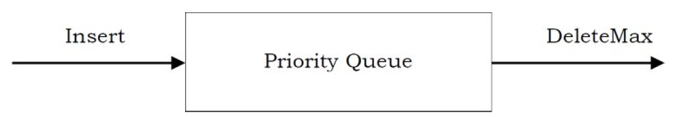
What is a Priority Queue?
A priority queue is called an ascending – priority queue, if the item with the smallest key has the highest priority (that means, delete the smallest element always).
Similarly, a priority queue is said to be a descending –priority queue if the item with the largest key has the highest priority (delete the maximum element always).
Since these two types are symmetric, we will be concentrating on one of them: ascending-priority queue.

Slide 8
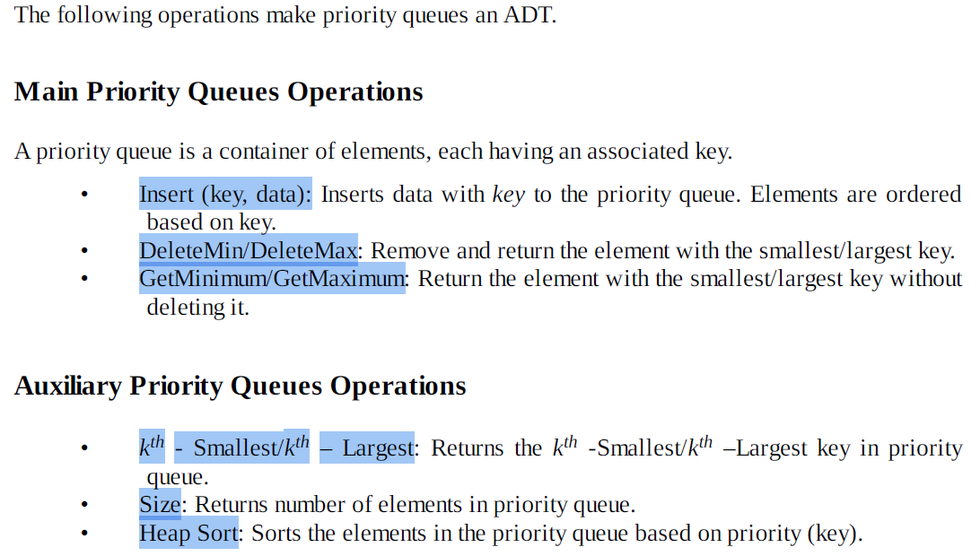
Priority Queue ADT

Slide 9
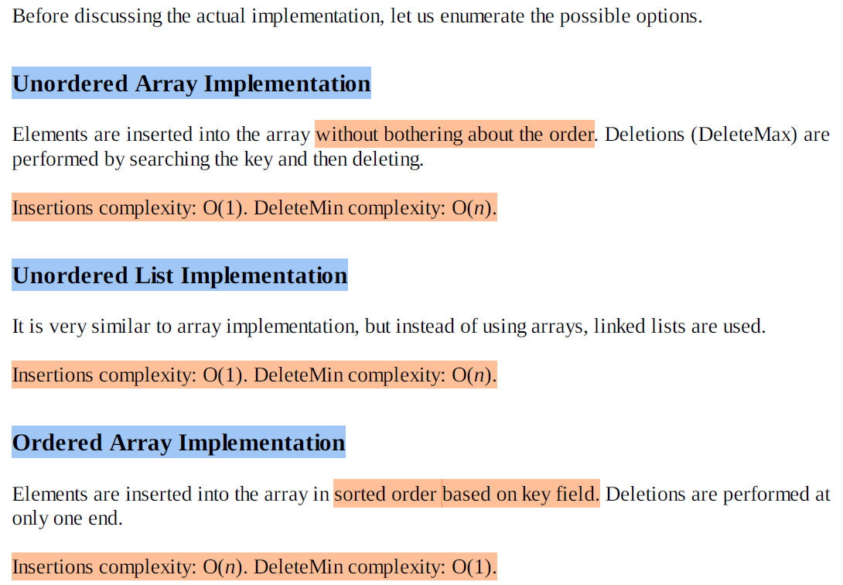
Priority Queue Implementations

Slide 10
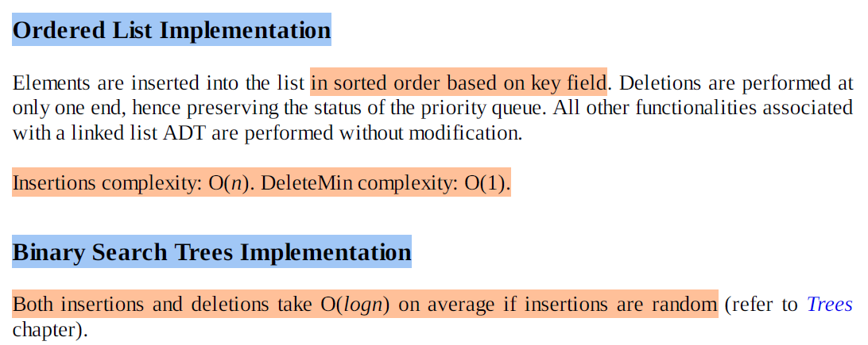
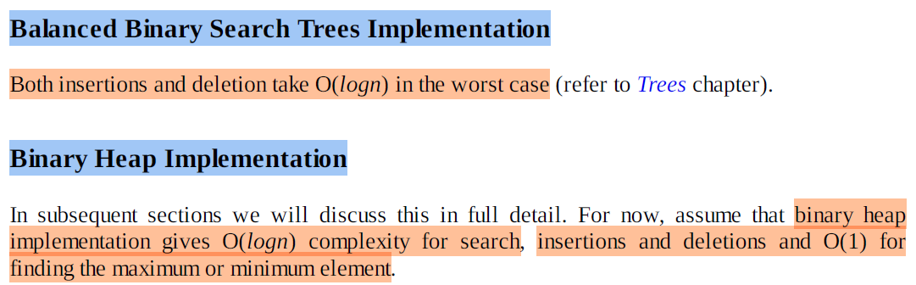
Priority Queue Implementations

Slide 11
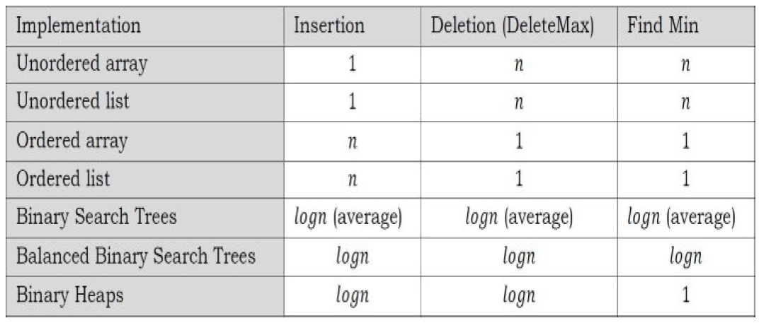
Comparing Implementations

Slide 12
Heaps and Binary Heaps
What is a Heap?
A heap is a tree with some special properties:
The value of a node must be ≥ (or ≤) than the values of its children. This is called heap property.
A heap also has the additional property that all leaves should be at h or h – 1 levels (where h is the height of the tree) for some h > 0 (complete binary trees). That means heap should form a complete binary tree (as shown below).
In the following examples, the left tree is a heap (each element is greater than its children) and the right tree is not a heap (since 11 is greater than 2).

Slide 13
Types of Heaps?
Based on the property of a heap we can classify heaps into two types:
Min heap: The value of a node must be less than or equal to the values of its children.
Max heap: The value of a node must be greater than or equal to the values of its children.

Slide 14
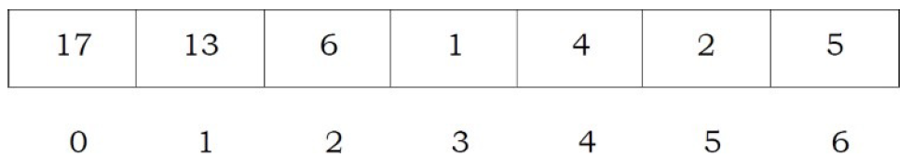
Binary Heaps
In binary heap each node may have up to two children. In practice, binary heaps are enough and we concentrate on binary min heaps and binary max heaps for the remaining discussion.
Representing Heaps: Before looking at heap operations, let us see how heaps can be represented.
One possibility is using arrays. Since heaps are forming complete binary trees, there will not be any wastage of locations. For the discussion below let us assume that elements are stored in arrays, which starts at index 0. The previous max heap can be represented as:

Slide 15
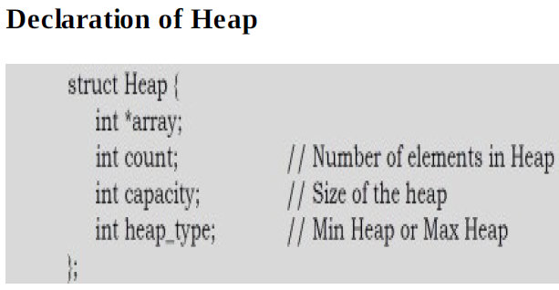
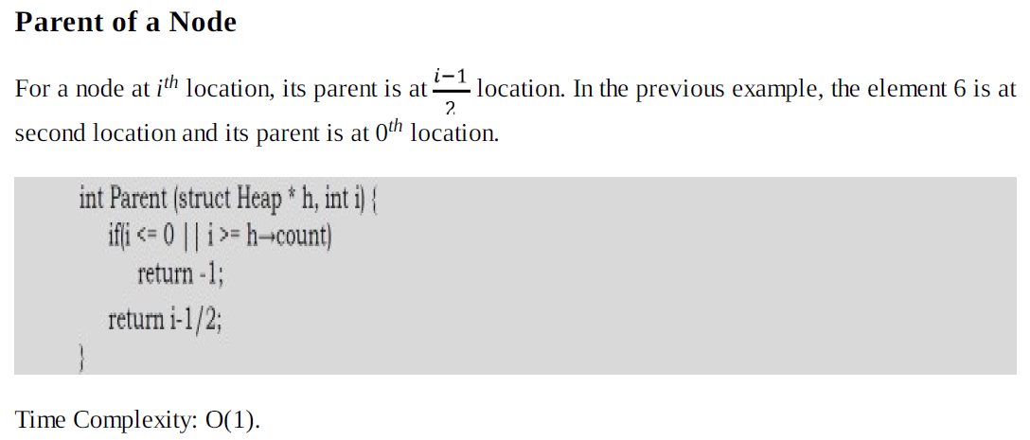
Binary Heaps

Slide 16
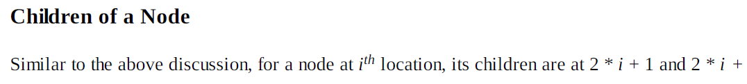
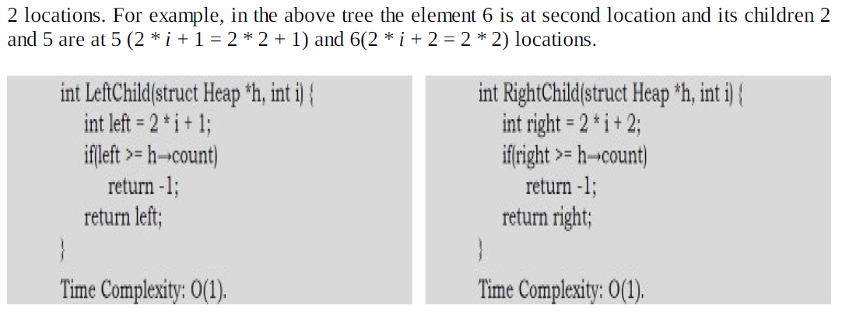
Binary Heaps

Slide 17
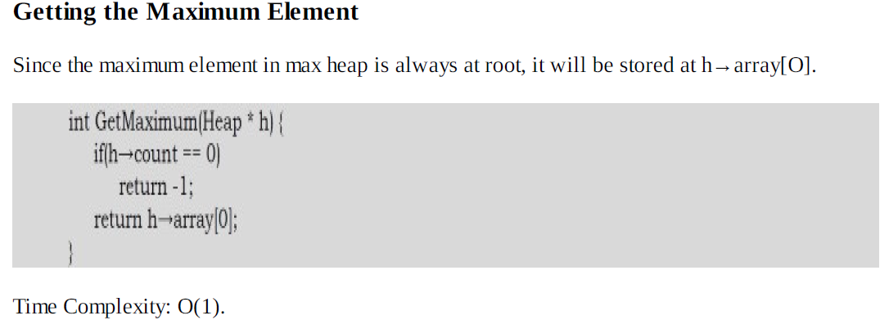
Binary Heaps

Slide 18
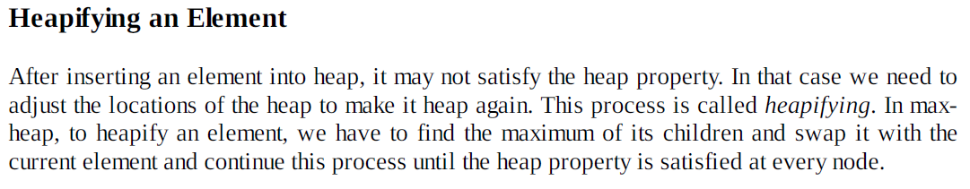
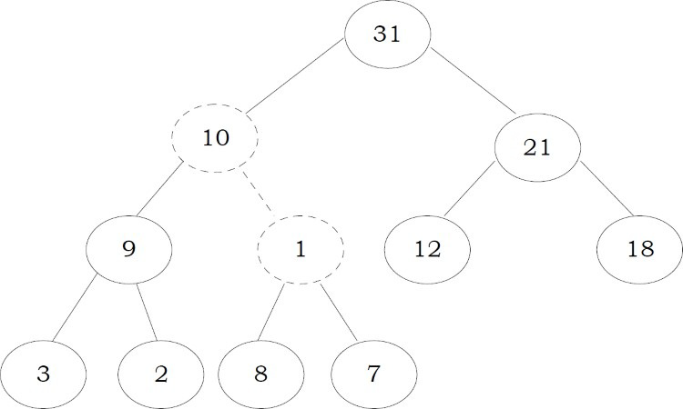
Binary Heaps
To heapify 1, find the maximum of its children and swap with that.
Now the tree is satisfying the heap property. In the above heapifying process, since we are moving from top to bottom, this process is sometimes called percolate down. Similarly, if we start heapifying from any other node to root, we can that process percolate up as move from bottom to top.

Slide 19

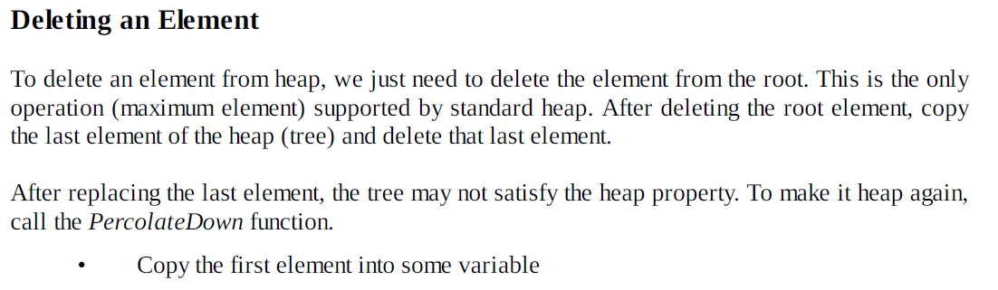


Binary Heaps

Slide 20
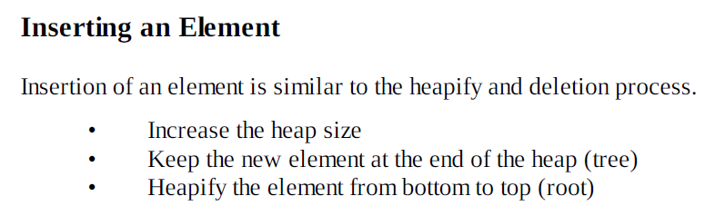

Binary Heaps
Example: we have inserted the element 19 at the end of the heap and this is not satisfying the heap property.

Slide 21
Heapifying the Array
One simple approach for building the heap is, take n input items and place them into an empty heap. This can be done with n successive inserts and takes O(nlogn) in the worst case. This is due to the fact that each insert operation takes O(logn).
Notes:
Leaf nodes always satisfy the heap property and do not need to care for them.
The leaf elements are always at the end and to heapify the given array it should be enough if we heapify the non-leaf nodes.
Now let us concentrate on finding the first non-leaf node. The last element of the heap is at location h → count – 1, and to find the first non-leaf node it is enough to find the parent of the last element.

Slide 22
Heapifying the Array

Slide 23
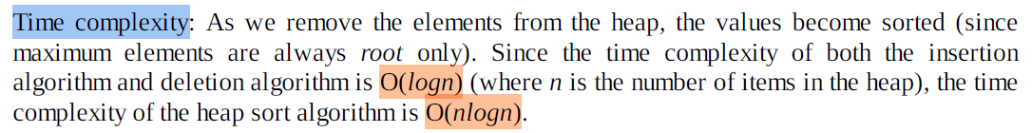
Heap sort
One main application of heap ADT is sorting (heap sort).
The heap sort algorithm inserts all elements (from an unsorted array) into a heap, then removes them from the root of a heap until the heap is empty.
Note that heap sort can be done in place with the array to be sorted. Instead of deleting an element, exchange the first element (maximum) with the last element and reduce the heap size (array size). Then, we heapify the first element. Continue this process until the number of remaining elements is one.

Slide 24
Sorting

Slide 25
Lecture Outline – Part Two
What is Sorting ?
Why is sorting necessary?
Classification of sorting algorithms
Bubble Sort
Selection Sort
Insertion Sort
Shell Sort
Merge Sort
Quick Sort
Heap Sort

Slide 26
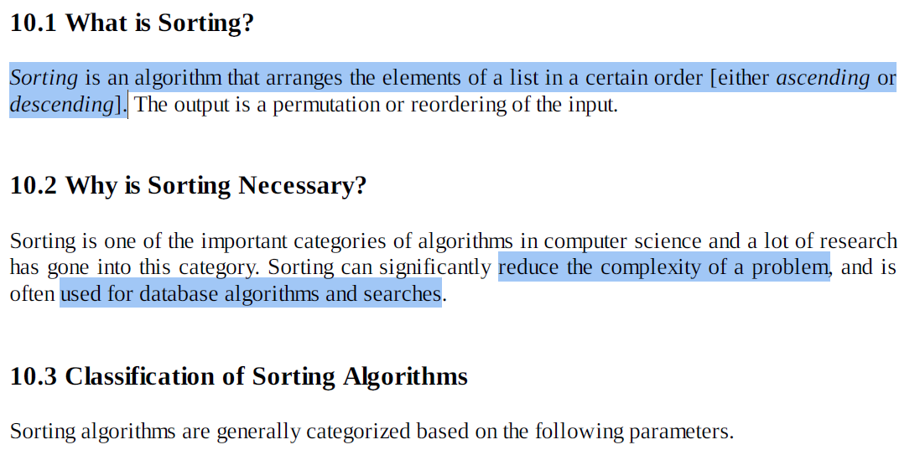
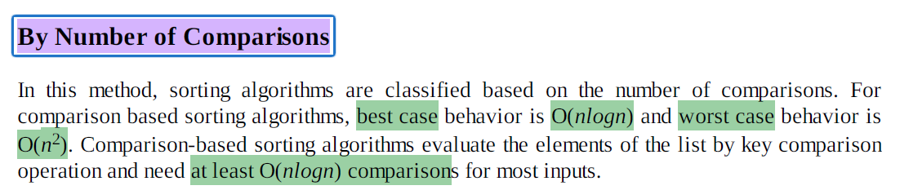
Sorting

Slide 27
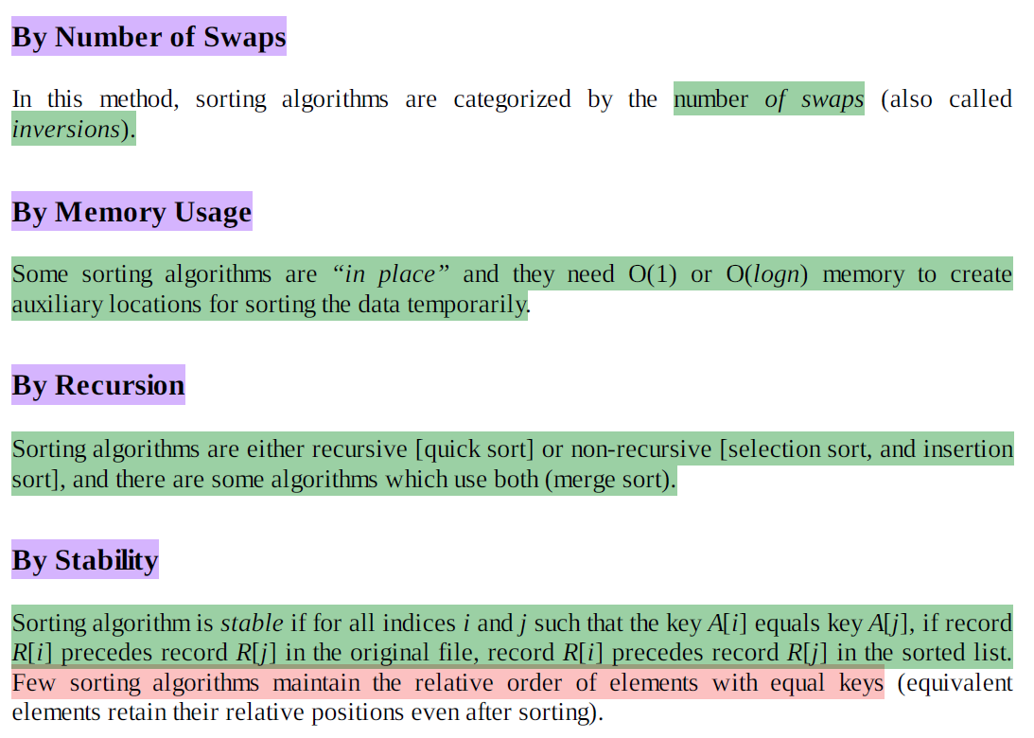
Sorting
Notes:
Sorting algorithms can be classified based on how much extra memory they need while sorting.
An in-place sorting algorithm sorts the data within the original array or list and uses only a very small amount of extra memory.
--------------------
A sorting algorithm is called stable if it preserves the relative order of records with equal keys after sorting.
Meaning of the definition (in simple terms)
If two elements have the same key value and one appears before the other in the original list, then after sorting:
The element that came first must still come first in the sorted list.

Slide 28
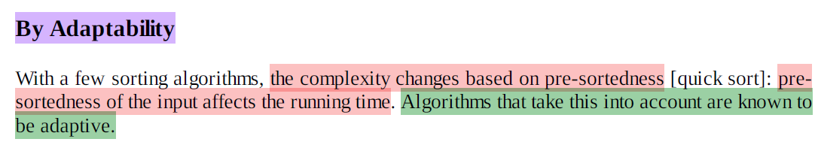
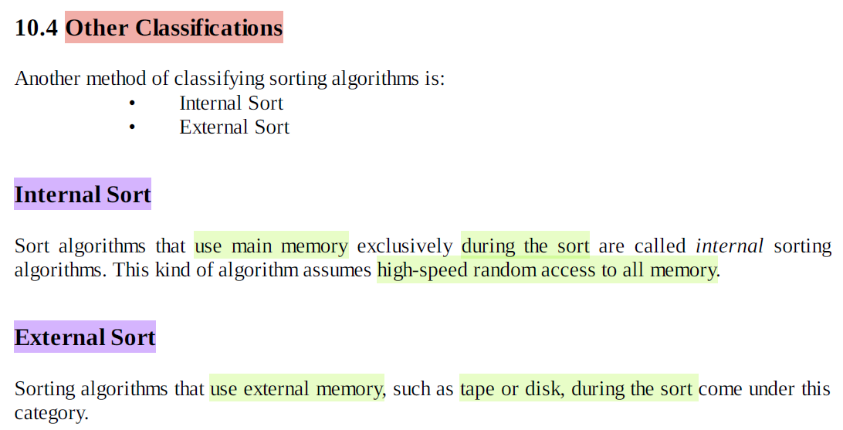
Sorting
Notes:
Sorting algorithms can be classified based on adaptability, which means how their performance changes
depending on how much the input data is already sorted.
A sorting algorithm is called adaptive if its running time improves when the input data is already partially or fully sorted.

Slide 29
Bubble Sort
In bubble sort, each element is compared with its adjacent element .
If the first element is larger than the second one, then the positions of the elements are interchanged , otherwise it is not changed .
Then next element is compared with its adjacent element and the same process is repeated for all the elements in the array until we get a sorted array
Let A be a linear array of n numbers.
Sorting of A means rearranging the elements of A so that they are in order.
Here we are dealing with ascending order. i.e., A[1] < A[2] < A[3] < ...... A[n].

Slide 30
Bubble Sort
Suppose the list of numbers A[1], A[2], …, A[n] is an element of array A.
The bubble sort algorithm works as follows:
Step 1 :
Compare A[1] and A[2] and arrange them in the (or desired) ascending order , so that A[1] <A[2].
i.e., if A[1] is greater than A[2] then interchange the position of data by
swap = A[1];
A[1] = A[2];
A[2] = swap.
Then compare A[2] and A[3] and arrange them so that A[2] < A[3]. Continue the process until we compare A[N-1] with A[N].
•
Note : Step1 contains n-1 comparisons i.e., the largest element is “ bubbled up ” to the nth position or “ sinks ” to the nth position.
When step 1 is completed, A[N] will contain the largest element.

Slide 31
Bubble Sort
Step 2 :
Repeat step 1 with one less comparisons that is, now stop comparison at A[N-1] and possibly rearrange A[N-2] and A[N-1] and so on.
Note : in the second pass , step 2 involves n-2 comparisons and the second largest element will occupy A[N-1].
And in the third pass , step3 involves n-3 comparisons and the 3rd largest element will occupy A[N-2] and so on.
Step n-1 :
Compare A[1] with A[2] and arrange them so that A[1] < A[2] .
After n-1 steps, the array will be a sorted array in increasing (or ascending) order .

Slide 32
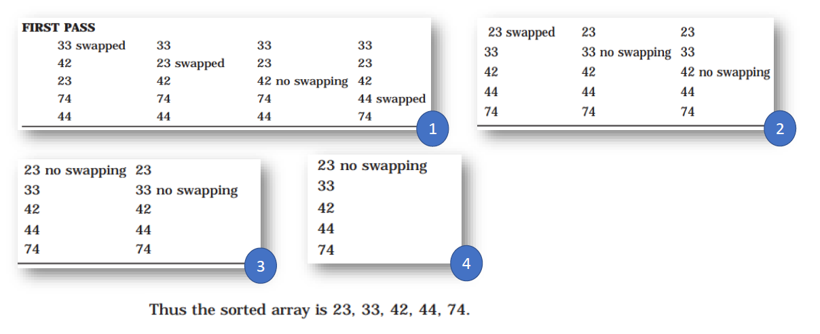
Bubble Sort
Example:
The following figures will depict the various steps (or PASS) involved in the sorting of an array of 5 elements. The elements of an array A to be sorted are: 42, 33, 23, 74, 44

Slide 33
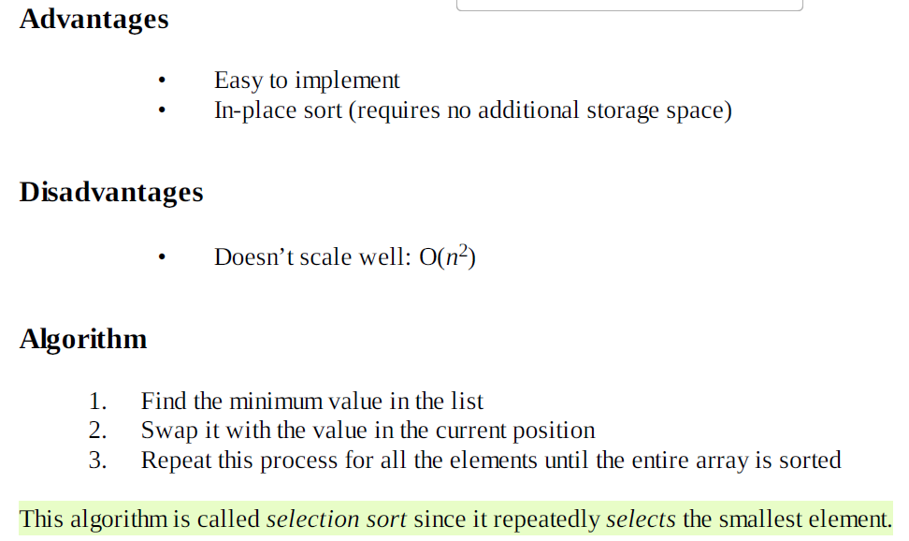
Selection Sort
Selection sort is an in-place sorting algorithm. Selection sort works well for small files.
It is used for sorting the files with very large values and small keys. This is because selection is made based on keys and swaps are made only when required.

Slide 34
Selection Sort
Example:
Following figure is generated during the iterations of the algorithm to sort 5 numbers 42, 33, 23, 74, 44:

Slide 35
Insertion Sort
Insertion sort is implemented by inserting a particular element at the appropriate position.
In this method, the first iteration starts with the comparison of 1st element with the 0th element.
In the second iteration, 2nd element is compared with the 0th element and 1st element.
In general, in every iteration an element is compared with all the elements before it. During comparison if it is found that the element in question can be inserted at a suitable position then a space is created for it by shifting the other elements one position to the right and inserting the element at a suitable position. This procedure is repeated for all the elements in the array.

Slide 36
Insertion Sort
Example:
To illustrate the insertion sort methods, consider a following array with five elements 42, 33, 23, 74, 44:

Slide 37
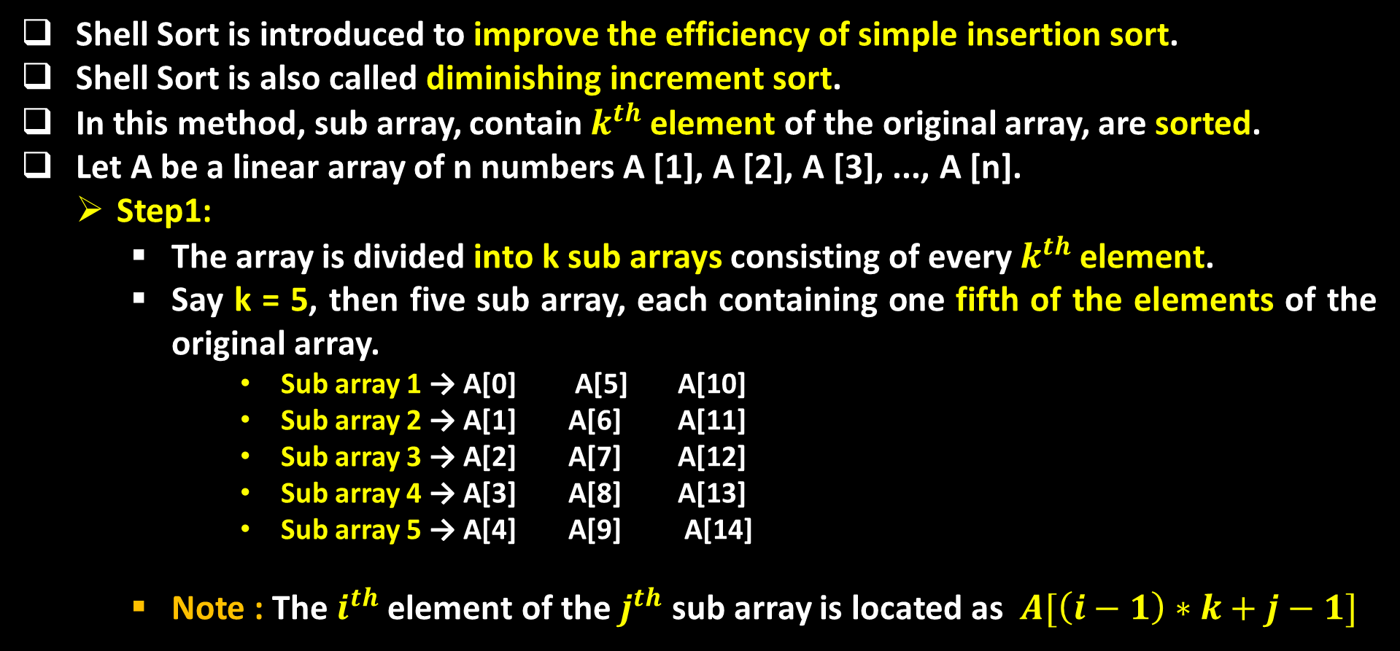
Shell Sort
Shell Sort is introduced to improve the efficiency of simple insertion sort.
Shell Sort is also called diminishing increment sort.
In this method, sub array, contain $k^{th}$ element of the original array, are sorted.
Let A be a linear array of n numbers A [1], A [2], A [3], ..., A [n].
Step1:
The array is divided into k sub arrays consisting of every $k^{th}$ element.
Say k = 5, then five sub array, each containing one fifth of the elements of the original array.
Sub array 1 → A[0] A[5] A[10]
Sub array 2 → A[1] A[6] A[11]
Sub array 3 → A[2] A[7] A[12]
Sub array 4 → A[3] A[8] A[13]
Sub array 5 → A[4] A[9] A[14]
Note : The $i^{th}$ element of the $j^{th}$ sub array is located as $A[\left(i−1\right)∗k+j−1]$

Slide 38
Shell Sort
Step2 :
After the first k sub array are sorted ( usually by insertion sort ) , a new smaller value of k is chosen and the array is again partitioned into a new set of sub arrays.
Step3 :
And the process is repeated with an even smaller value of k, so that A [1], A [2], A [3], …, A [n] is sorted.
Note: if k = 1, the shell sorting sorts using the algorithm of insertion sort.

Slide 39
Shell Sort
Example:
To illustrate the shell sort, consider the following array with 7 elements 42, 33, 23, 74, 44, 67, 49 and the sequence K = 4, 2, 1 is chosen.

Slide 40
Merge Sort
Merging means combining two sorted lists into one sorted list. For this the elements from both the sorted lists are compared .The smaller of both the elements is then stored in the third array .The sorting is complete when all the elements from both the lists are placed in the third list.
Divide the array into approximately n/2 sub arrays of size two and set the element in each sub array.
Merging each sub array with the adjacent sub array will get another sorted sub array of size four .
Repeat this process until there is only one array remaining of size n
Since at any time the two arrays being merged are both sub arrays of A, lower and upper bounds are required to indicate the sub arrays of a being merged.

Slide 41
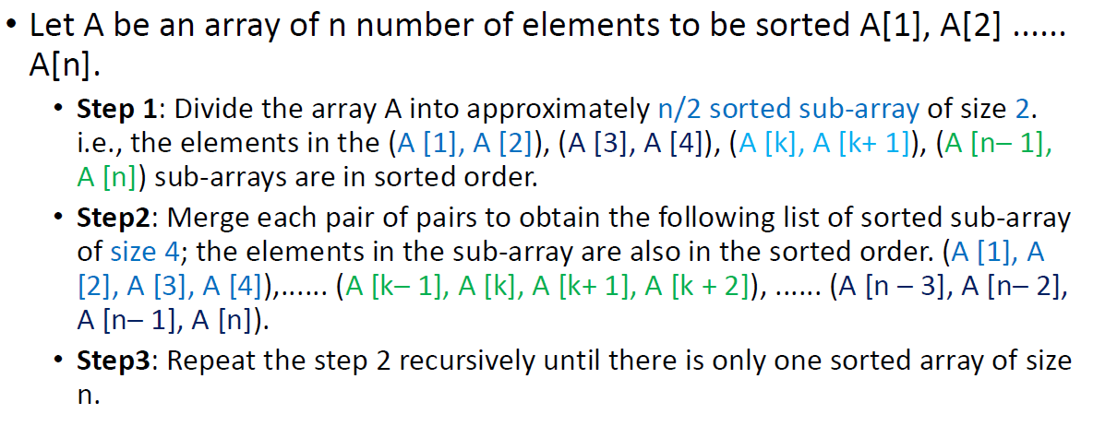
Merge Sort

Slide 42
Merge Sort
Example:
To illustrate the merge sort algorithm, consider the following array with 7 elements [42], [33], [23], [74], [44], [67], [49]

Slide 43
Quick Sort
It is one of the widely used sorting techniques also called the partition exchange sort.
Quick sort is an efficient algorithm passes a very good time complexity in average case.
It is an algorithm of the divide and conquer type.
The quick sort algorithm works by partitioning the array to be sorted .
And each partitions are internally sorted recursively .
In partition the first element of an array is chosen as a key value.
This key value can be the first element of an array.
That is, if A is an array, then key = A (0) , and rest of the elements are grouped into two portions.

Slide 44
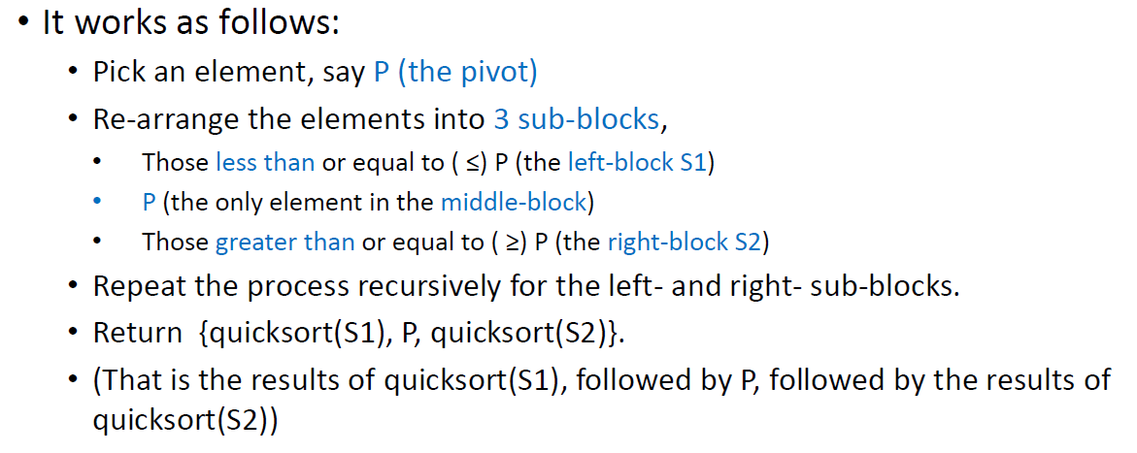
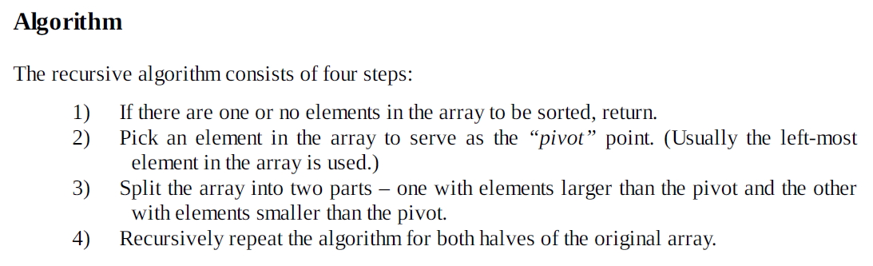
Quick Sort

Slide 45
Quick Sort
Example:
20 55 46 37 9 89 82 32
20 55 46 37 9 89 82 32
(9) 20 (55 46 37 89 82 32)
9 20 55 46 37 89 82 32
9 20 (46 37 32) 55 (89 82)
9 20 (46 37 32) 55 (89 82)
9 20 (37 32) 46 55 (89 82)
9 20 32 37 46 55 (89 82)
9 20 32 37 46 55 82 89

Slide 46
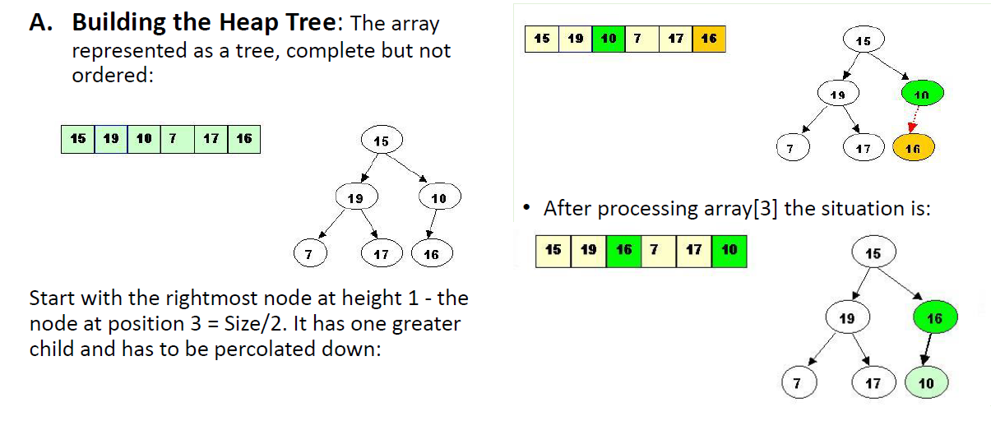
Heap Sort

Slide 47
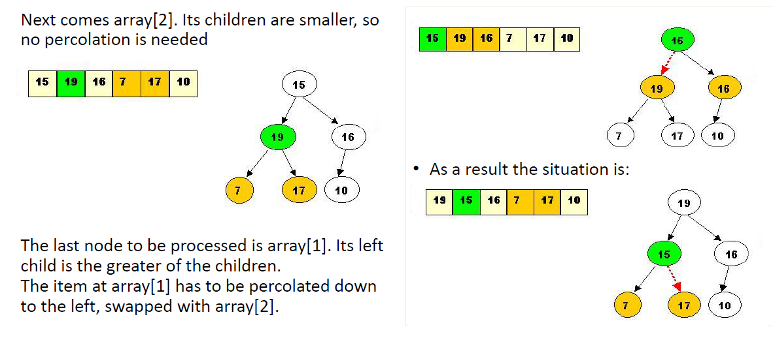
Heap Sort

Slide 48
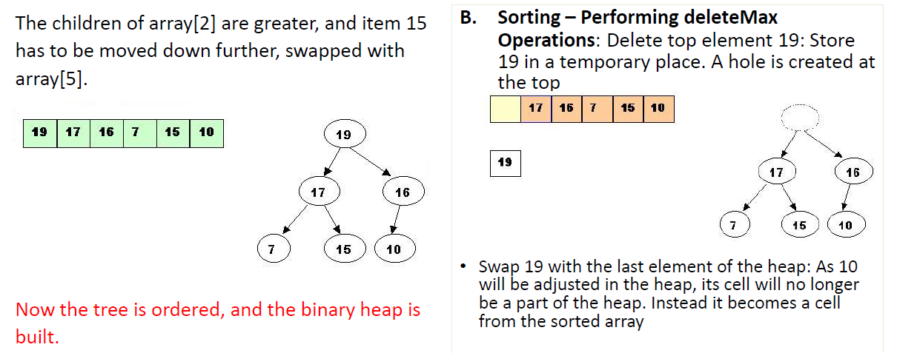
Heap Sort

Slide 49
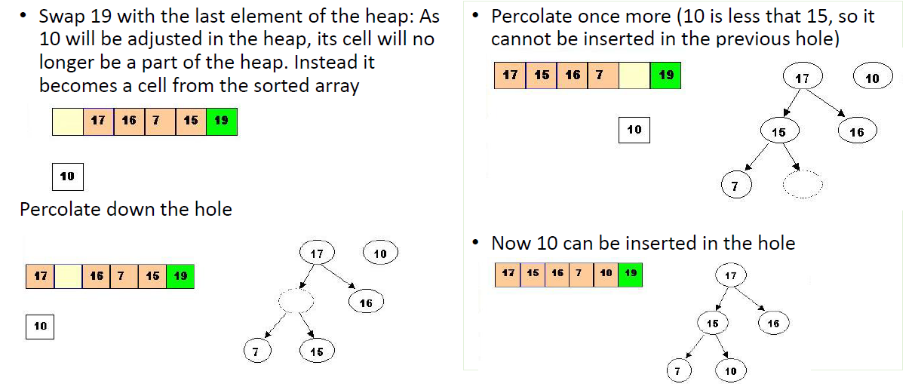
Heap Sort

Slide 50
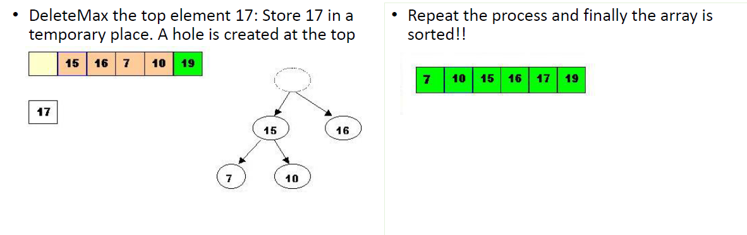
Heap Sort

Slide 51


